Slide 1
Sprint 5 Delivery
Group 1 - Alex, Angel, Atanas, Stoyan, Tsanko
Notes:
Goal of the sprint:
Improve performance
look into a time series database
work on summary tables and events for inserting
finish alerting.
All are on 90%

Slide 2
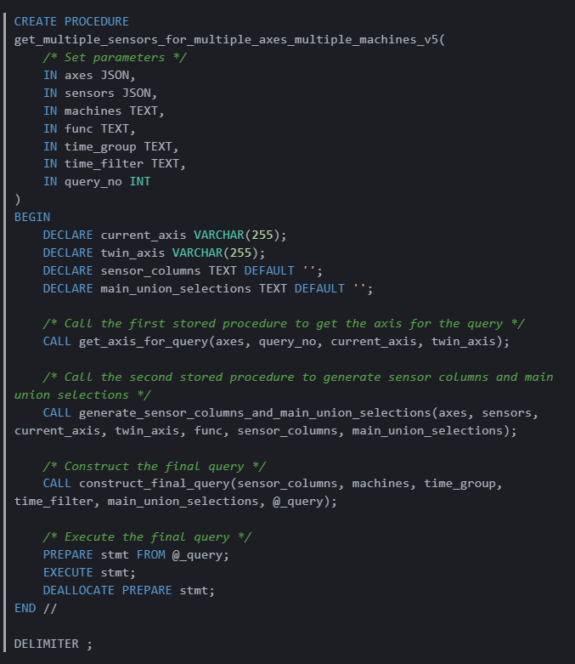
Flexible Query v5

Slide 3
Trensfer dokument

Slide 4
Neshto drugo, za posle

Slide 5

What’s next?
Notes:
Finish tasks this week and hand over deliverables
Alert selection queries

Slide 6
Thank you for your time

